Slide 1
Findings on topk activations

Slide 2
VITL16 Model results

Slide 3
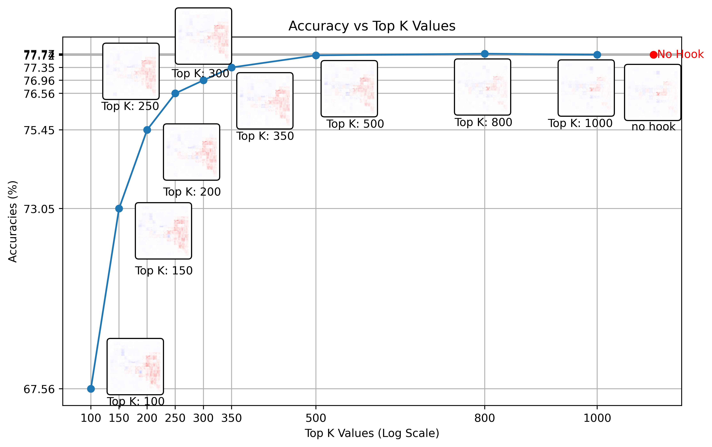
VIT L 16 Model accuracy (Tested on imagenet val set (6.4GB))

Slide 4

VIT L 16 Model heatmaps with different k values

Slide 5

VIT L 16 Model heatmaps noise
Idea: choose reference image with “good” relevances → heatmap obtained with gamma rule
Calculate MSE between reference image and topk produced images to get some measure of “noise” or “quality” of heatmap
Reference image

Slide 6
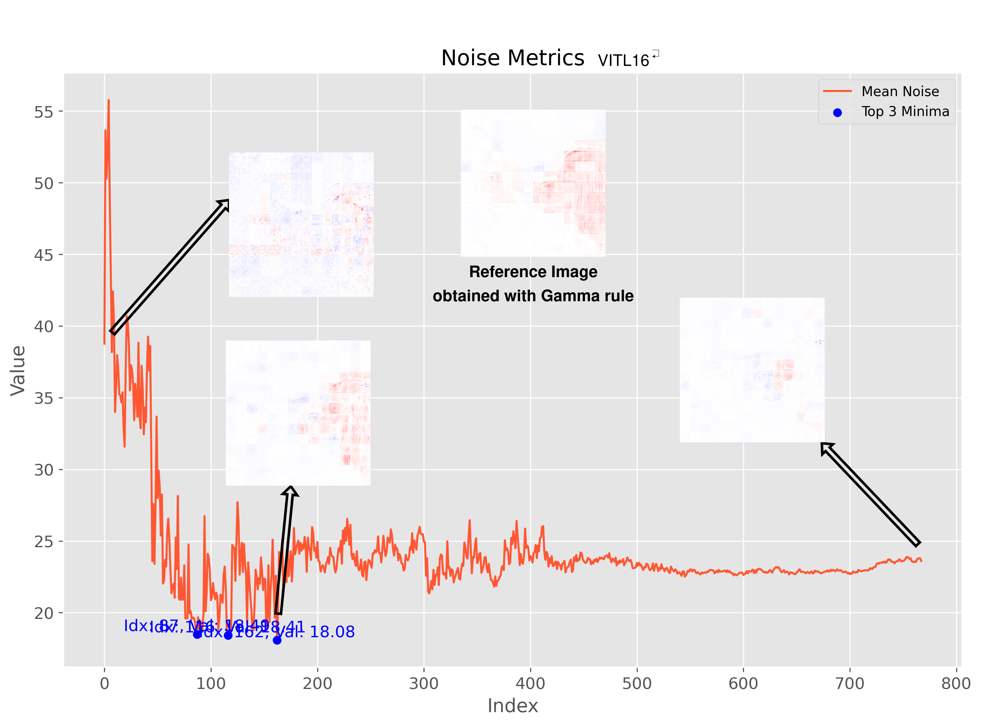
VIT L 16 Model noise

Slide 7
VITB16 Model results

Slide 8
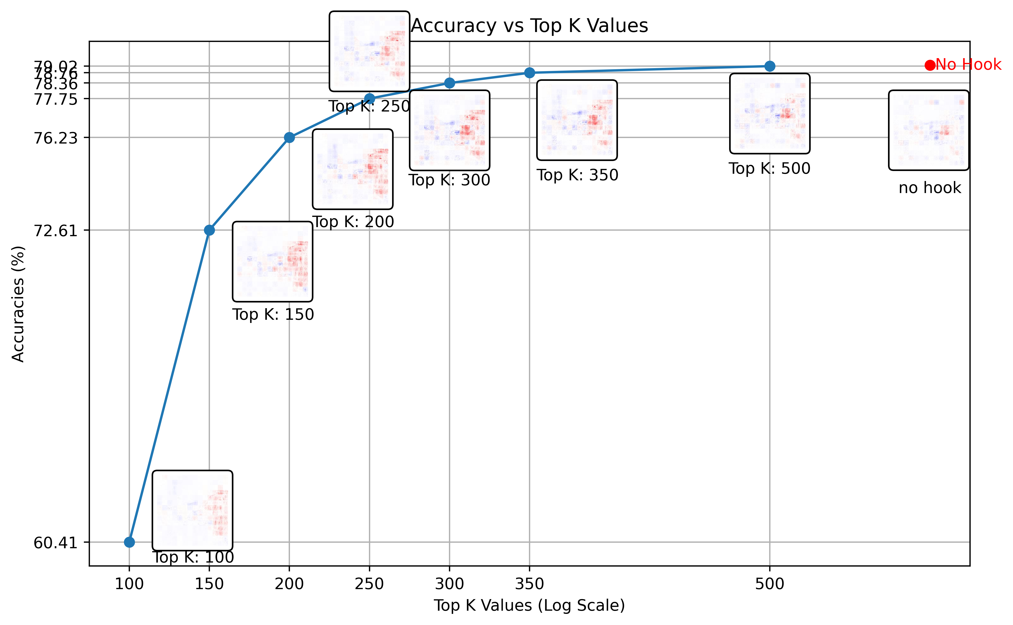
VIT B 16 Model accuracy (Tested on imagenet val set (6.4GB))

Slide 9

VIT B 16 Model heatmaps with different k values

Slide 10
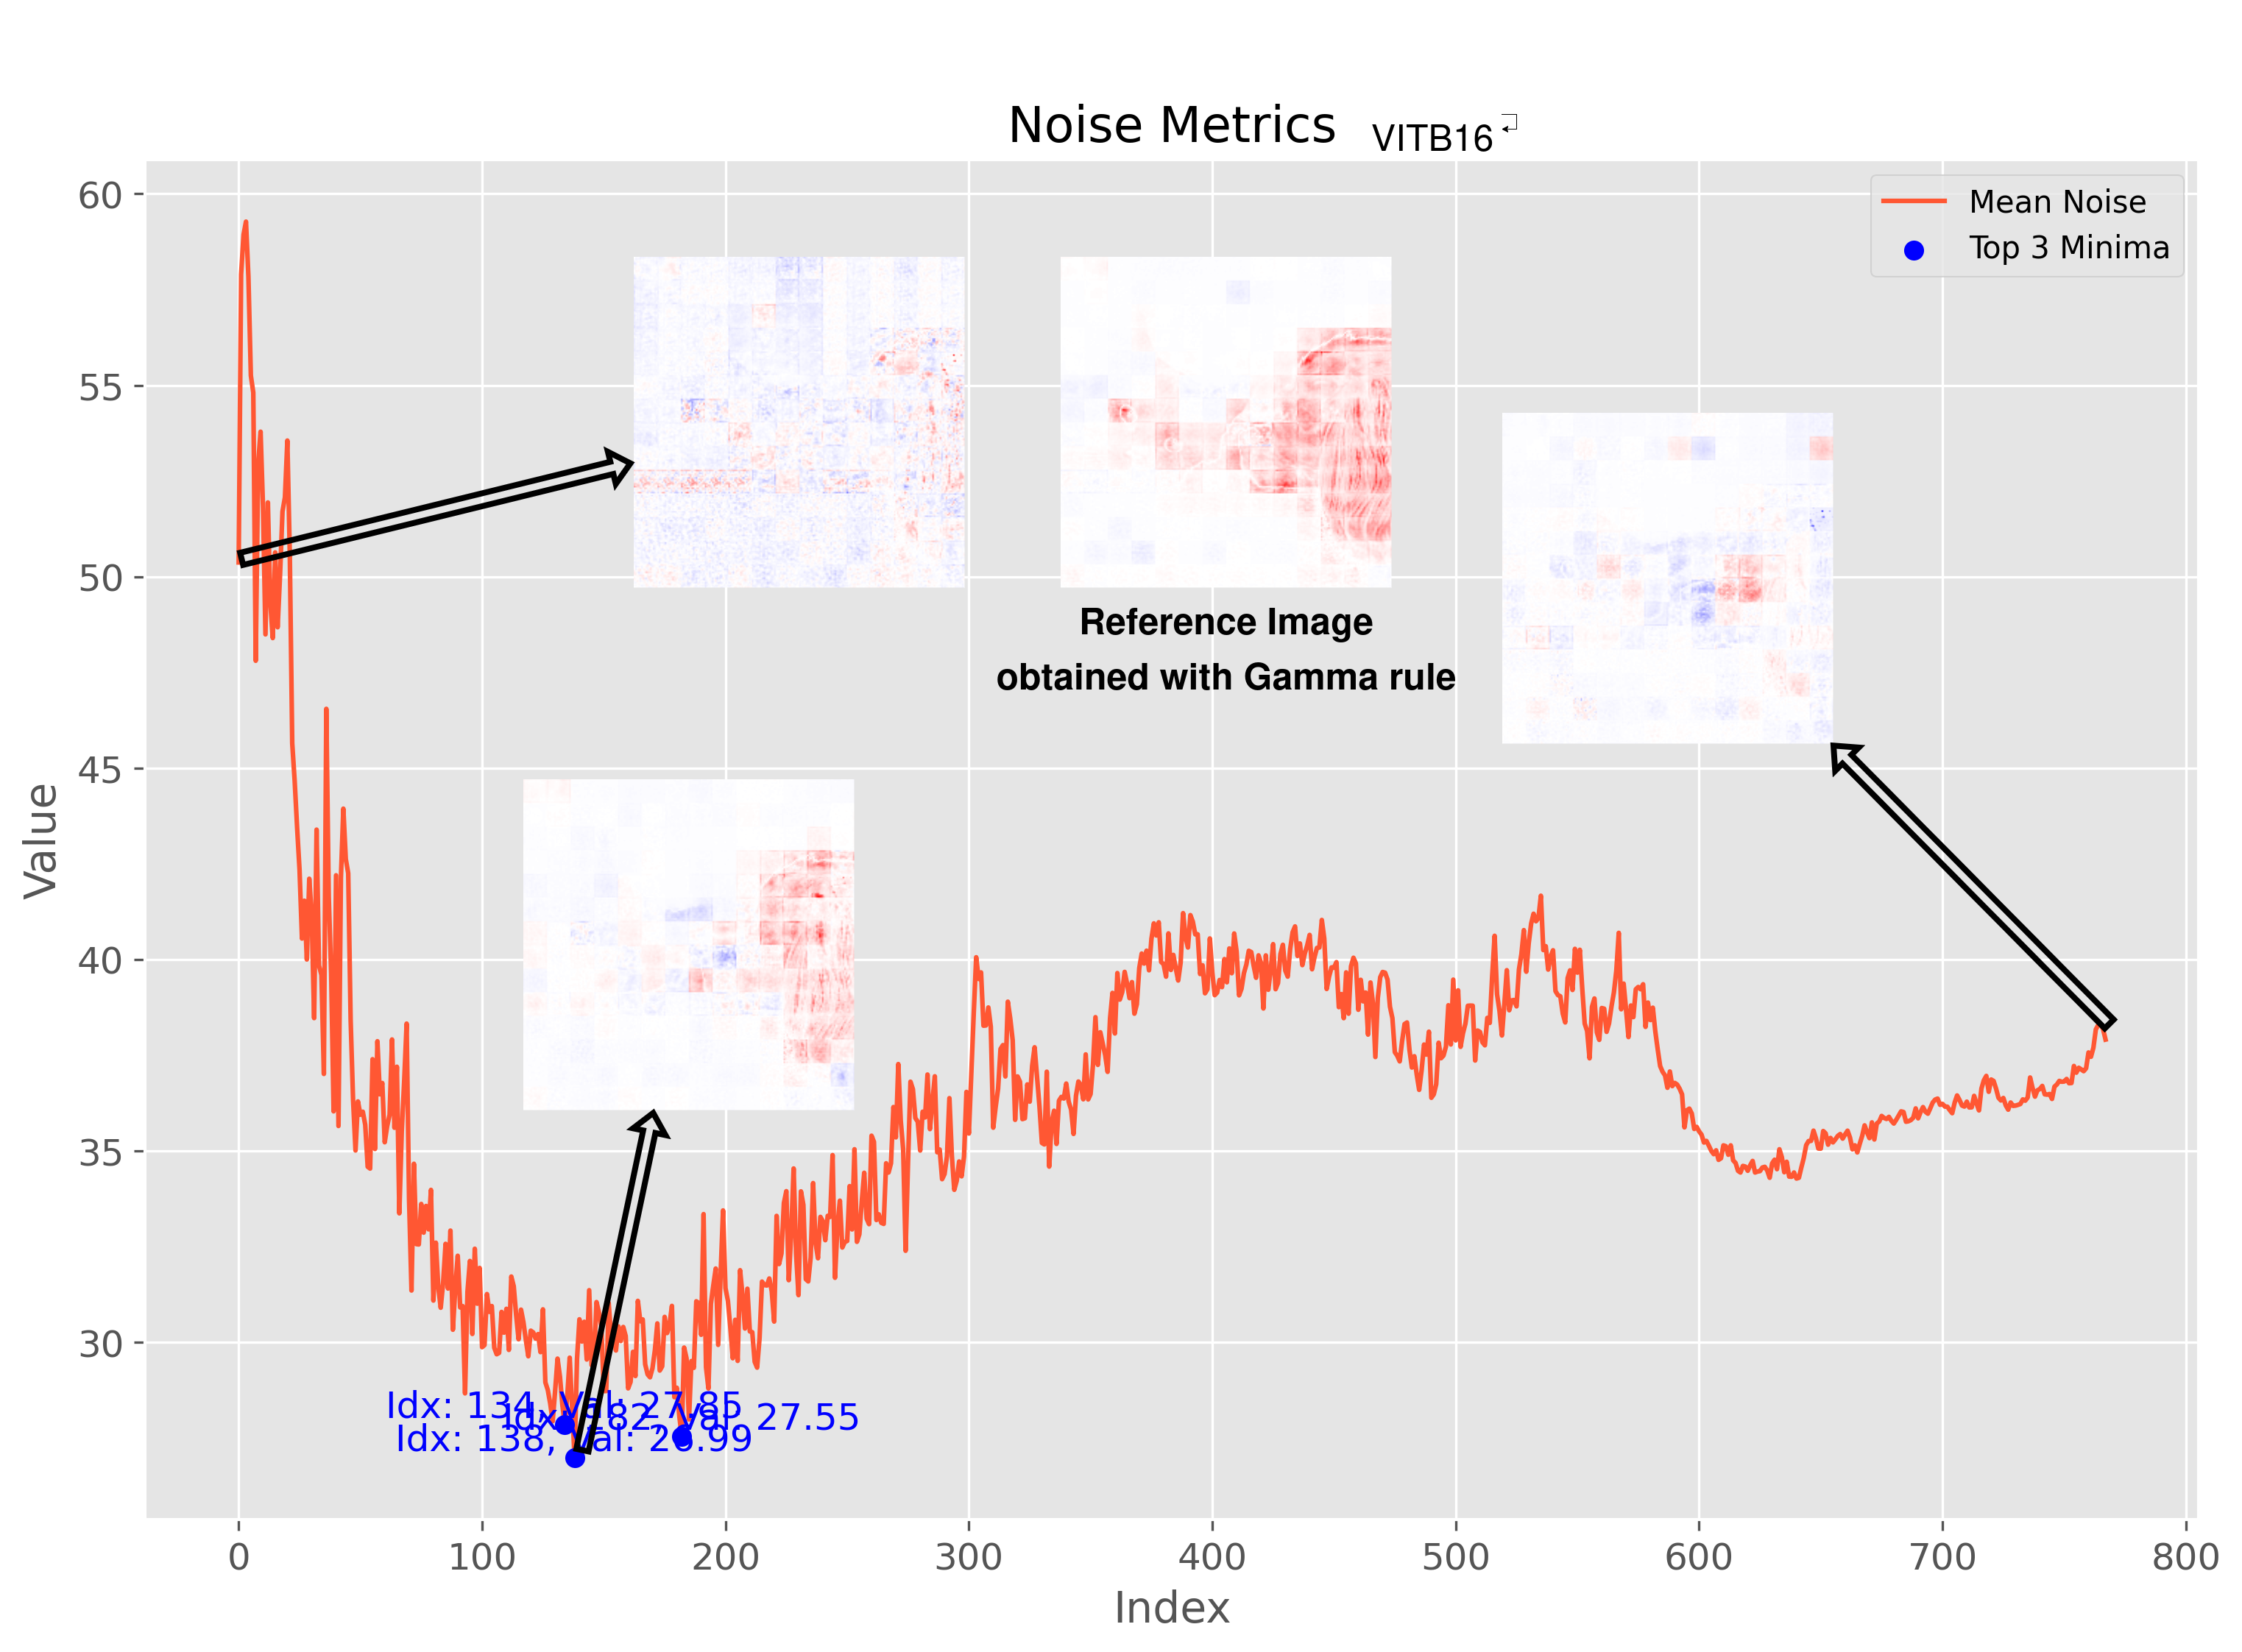
VIT L 16 Model noise

Slide 11
ToDo
Further investigate fourier transform analysis
Find better error/noise measure
Investigate connection between topk value and quality of heatmap, as the plots suggest no linear trend with high volatility

